Slide 1
Lesson 8
E115 – Programming and Data Analysis

Slide 2
Lesson objectives
At the end of the lesson, you should be able to:
Use VBA in-built InputBox dialog box
Create a userform to capture user’s input using the following Toolbox Controls:
CheckBox
ComboBox
CommandButton
Image
Label
SpinButton
Textbox

Slide 3
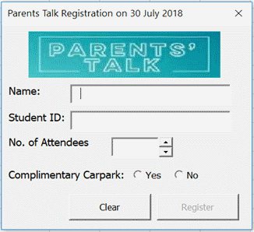
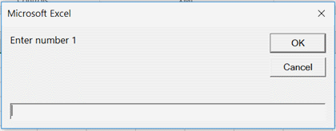
What is a Userform?
A Userform is a custom-built dialog box that makes a user data entry more controllable and easier to use for the user.
We are going to learn 2 types of dialog box
VBA in-built Inputbox function
Customised VBA Userform

Slide 4
VBA InputBox function
This function allows user to enter one piece of information only.
Prompt | Required | The text displayed in the input box
Title | Optional | The caption displayed in the title bar of the dialog box
Default | Optional | The default value to be displayed in the dialog box
Left, Top | Optional | Specifies the x and y position of the upper left corner of dialog box respectively
HelpFile, HelpContextID | Optional | The name of the Help file and context ID number of the help topic in the Help file for this dialog box.
Type | Optional | Specifies the return data type. Default is text.

Slide 5

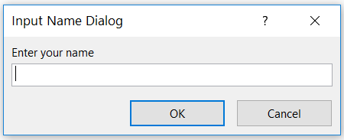
Do it with me
Step 1: Create a new Excel file with a blank sheet.
Step 2: Open the Visual Basic window and insert a new module.
Step 3: Type the following codes and run it. What do you see?
Question: How would you store the NameText in Sheet1 cell A1?
→ Sheet1.Range(“A1”).value = NameText
Question in the dialog box
Title of the dialog box

Slide 6
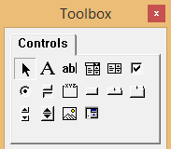
Customised UserForm
These are the Toolbox controls available when you create a UserForm in Excel VBA.
Label – display text
Textbox – allow user type text/value
ComboBox – list of items in a drop-down box and display one item at a time.
ListBox – list of items where user can select more than one item.
CheckBox – useful for getting binary choice (yes/no)
ScrollBar –Select value from a list
SpinButton– Select value by clicking up or down arrow. Usually used with a TextBox to display the current value of SpinButton.
Image – display a graphic image.
RefEdit– allow user to select a range in a worksheet.
OptionButton – allow user to select one item from a group of choices.
ToggleButton– has two states (on/off)
Frame – enclose other controls for aesthetic or logically grouping purposes.
CommandButton – run a macro when user clicks
TabStrip – create tab control
MultiPage – create tabbed dialog boxes
Notes:
You can add as many controls as you want in the Userform to capture the necessary information you need from your users.

Slide 7
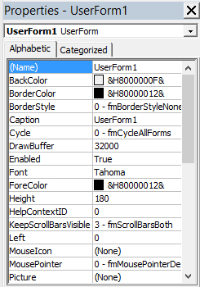
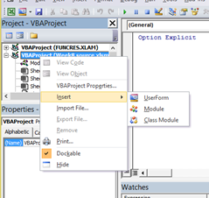
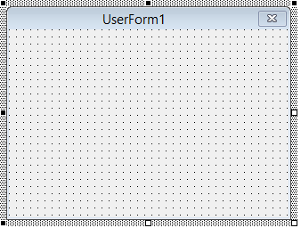
Do it with me
Let’s recreate VBA in-built InputBox function using User form.
Step 1: Open IS_Exercise.xlsm. Go to the Visual Basic window and insert a new UserForm.
You can view the properties of the UserForm created via the Properties Window.
Step 2: Change Caption to “Input Form”. What do you observe?

Slide 8
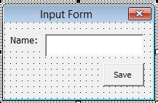
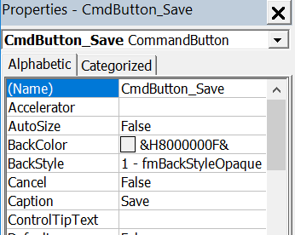
Do it with me
Step 3: Insert a Label by clicking on and select the place to put this label on the UserForm.
Step 4: Insert a Textbox by clicking on and place it on UserForm.
Step 5: Insert a CommandButton
You should have created a UserForm that looks like this:
You can change the font and size too.
(Properties → Font)
Good practice:
Rename your controls in the Properties window. (choose useful names)
Rename the following:
1. “Save” button → CmdButton_Save
2. Textbox → TextBox_Name

Slide 9

Do it with me
Step 6: Double click on the “Save” button and enter the following codes in the CmdButton_Save_Click subroutine.
Question: When will this subroutine be called?
→ When the save button is clicked.

Slide 10
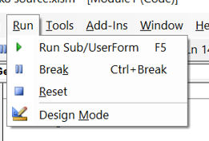
Test your UserForm
Only Subroutines created in modules are appeared in the Macro List.
How to test your UserForm? You can follow any of the following methods:
Press F5.
Click on icon (Run Sub/UserForm) on the standard toolbar.
Choose Run → Run Sub/UserForm command on the main menu.

Slide 11

Toggle between UserForm and its codes
Right-click on UserForm1. Choose “View Code” to see the codes related to this userform.

Slide 12

Event Handler Procedures
This is a generated event handler procedure by Excel. From the name, you can see that this procedure is called when Save button is clicked.
You can create an event handler procedure to initialise all the controls (set to default values or statuses) in the UserForm by choosing Initialize from the procedure dropdown list.
You can add codes here to initialise your controls

Slide 13
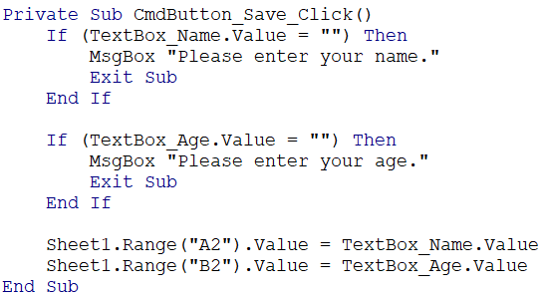
Exercise
Continue with your UserForm1 and create another Textbox to store the age of the user in column B of Sheet 1 of IS_Exercise.xlsm. Also include checks that user has entered name and age before saving.
Answer:
Exit the subroutine when the condition is not met. This is so because you do not want to continue the remaining of the codes and save a empty name.

Slide 14

Exercise
Create another CommandButton named “Clear” to clear all the Textbox values.
Answer:

Slide 15



Types of selection controls
The following are the common controls used to allow user selection:
Single Checkbox: user can select to turn on or off only.
Checkbox list: user can select one or more of the options.
Radio button list: user can only select only one out of a list of options.
Combo Box (aka Dropdown list): user can select one option from a large number of items

Slide 16

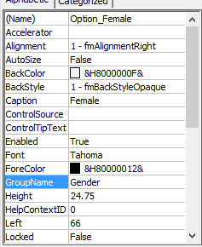
Do it with me (Radio Button)
Continue with your UserForm1
Step 1: Create two radio buttons to allow users to choose their gender (Male / Female).
Step 2: Give appropriate names to the radio button controls.
Step 3: Give appropriate group name to these two radio button controls. This is to allow Excel to recognise which radio button controls are grouped and only 1 option in this group can be selected.

Slide 17
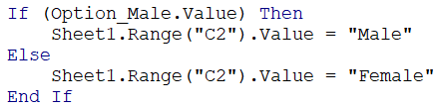

Do it with me (Radio Button)
Step 4: Add the following codes in “Save” event handler.
Question: What will be saved in column C when the user did not choose the gender?
Female
Question: What codes to be added to check that user has selected either “Male” or “Female” before saving?
The value of radio button is either TRUE (selected) or FALSE (not selected)

Slide 18
Common control functions
Function | Operation | Example
Enabled | Enable or disable control (not allowing user to choose) | Textbox.Enabled = True RadioOpt.Enabled = False
Visible | Show or hide control | Textbox.Visible = True RadioOpt.Visible = False
Value | Value of control | Textbox.Value = “Albert” RadioOpt.Value = False

Slide 19

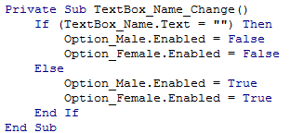
Do it with me (Disable controls)
How to make the radio buttons enable only after users enter name?
Step1: Disable radio buttons in Userform Initialise subroutine.
Step2: Double click on the name textbox to generate an event handler. When users enter their name, this will be called. Type the following in the event handler.
When user deletes name, these radio buttons will be disabled.
Can use TextBox_Name.Value too!

Slide 20

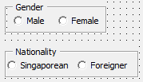
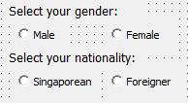
Frame the controls
It is useful to frame your controls to let users see which controls belong to the same group.
Which of the following gives a better understanding of all the controls?
You may also do this way without using frames

Slide 21
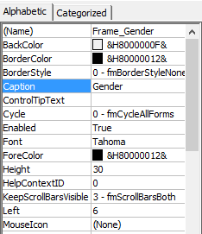

Do it with me (Frame)
Continue with UserForm1
Step 1: Create a Frame for the two gender radio controls.
Step 2: Drag the “Male” and “Female” radio controls into the Frame.
Step 3: Give appropriate Frame name and Caption.
Try moving the frame around. What happen to the controls inside the frame?

Slide 22

Do it with me (Check Box)
Continue with UserForm1
Step 1: Create a frame and name it “Favourite subjects”
Step 2: Create four check boxes to allow users to choose the subjects they like (English, Maths, Science, 2nd Language).
Remember to give appropriate names to controls!
Question: How would you save this information on favourite subjects in Column D to G in Sheet1?
Users can select more than one options

Slide 23
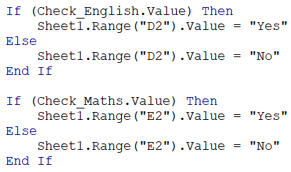
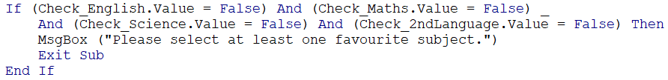
Exercise
Add codes in “Save” event handler to save this information on favourite subjects in Column D to G in Sheet1.
Answer:
Add the codes to check that users have selected at least one subject.
Answer:

Slide 24
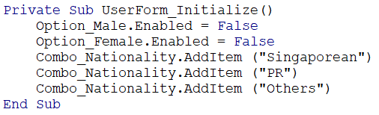
Do it with me (Combo Box)
Continue with UserForm1
Step 1: Create one ComboBox for users to select their Nationality. Name the control as Combo_Nationality.
Step 2: Enter these codes in Userform_Initialize
Question: How many items will be listed in the ComboBox?
→ 3

Slide 25

Do it with me (Combo Box)
Step 3: To prevent users from typing their own response in the ComboBox, select the following under Style in the Properties Window:
Question: How would you write the codes to save the user’s nationality in Sheet 1 column H?

Slide 26

Do it with me (Spin Button)
Continue with UserForm1
Step 1: Create a Spin Button control to allow users to spin the value of the number of siblings they have. Give appropriate control name and set the max to 5 and min to 0.
Step 2: Create a textbox to store the spin value.
Step 3: Double-click on the Spin Button and type the following codes in the Spin Button Change subroutine.
Question: What do the above codes mean?
Store the spin value in the textbox.

Slide 27
Image control
How would you insert an image for your Userform?
Choose and explore where you can insert your image on the properties window.

